Slide 1

What is TEACH?
TEACH is an electronic account, established by you,
so that NYS has a profile regarding your eligibility to teach.
TEACH acts as a warehouse for all of the information pertaining to your certification.

Slide 2
Steps to Initial Certification
Create a TEACH Account
Fingerprinting
NYSCTE Exams
Certification

Slide 3
Tips to Create a TEACH Account
Make sure you don’t already have a TEACH account.
Don’t forget your User Name and Password!
If you already have a TEACH account, DO NOT CREATE A NEW ACCOUNT! Use “Forgot Your Username or Password” at the bottom, or contact TEACH directly.
Canisius cannot help you retrieve your username or password
Creating a User Name and Password does not mean your account is all set up. You have to go through the login process.

Slide 4
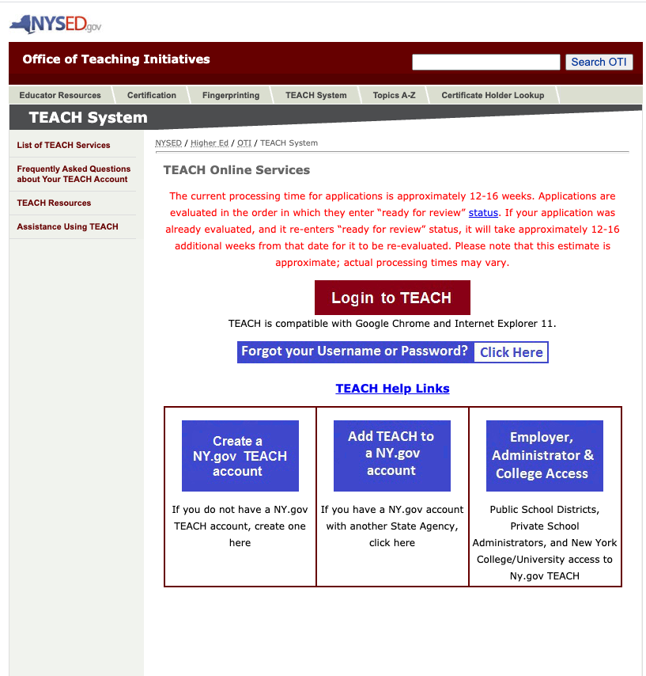
Create a TEACH Account
http://www.highered.nysed.gov/tcert/teach/
Click on this link

Slide 5
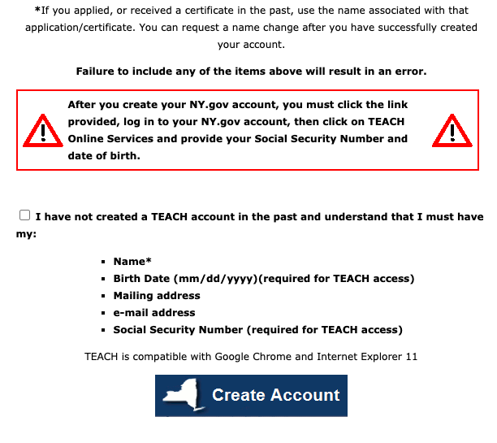

Create a TEACH Account
Check box
Click here to create account

Slide 6
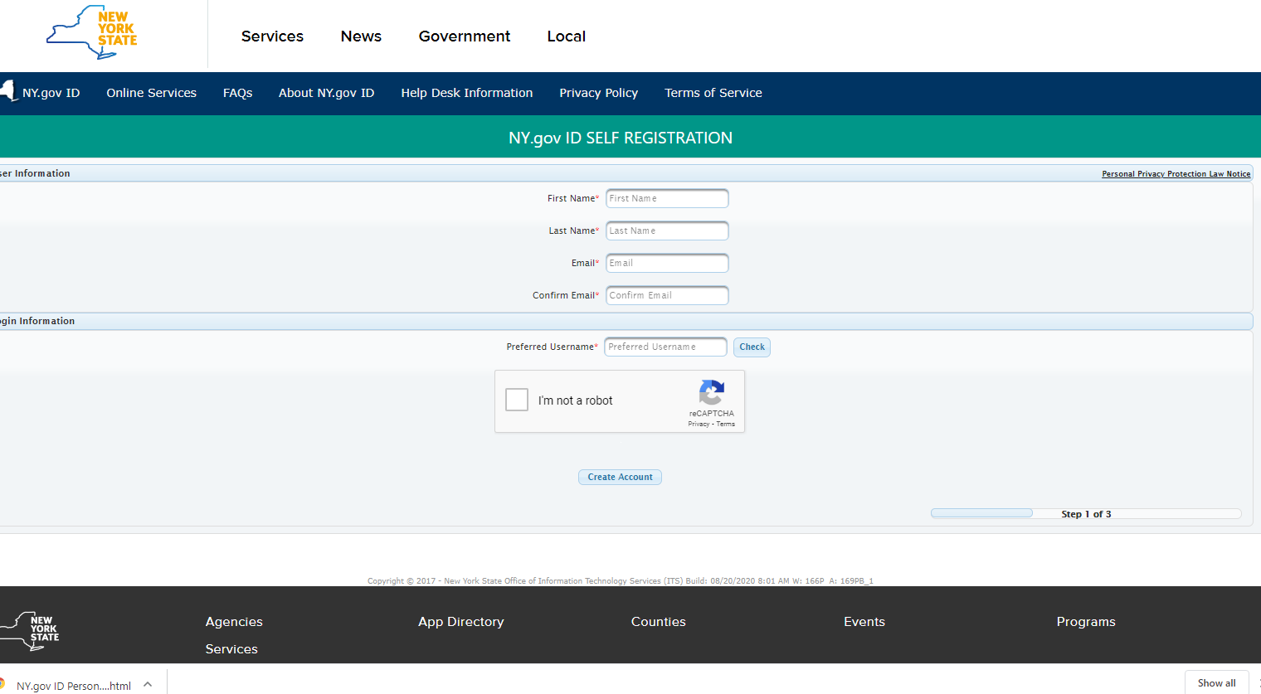
Create a TEACH Account

Slide 7
Fingerprinting
Visit NYSED New Procedures for Fingerprinting for fingerprinting instructions.
All applicants for New York State Teacher Certification are required to have a fingerprint supported criminal history background check processed through the Office of School Personnel Review and Accountability (OSPRA)
After your fingerprints have been processed by OSPRA, your TEACH account will contain the following statement: "Your DCJS and FBI results have been received". You will not receive anything from OSPRA unless a school district requests a fingerprint clearance report for you.
It typically takes 24 hours for fingerprints to be processed through OSPRA.
Total Cost for fingerprinting - $102.00

Slide 8
NYSED New Procedures for Fingerprinting - Link
Click Link

Slide 9
https://uenroll.identogo.com/workflows/14ZGQT
You are exiting the New York State
Education Department's (NYSED) web site.
The site you are about to visit (Schedule fingerprinting for Certification applicants) is not under the jurisdiction of the NYSED, and the NYSED is not responsible for its
content.
Click the link above to continue or CANCEL
Click Link

Slide 10
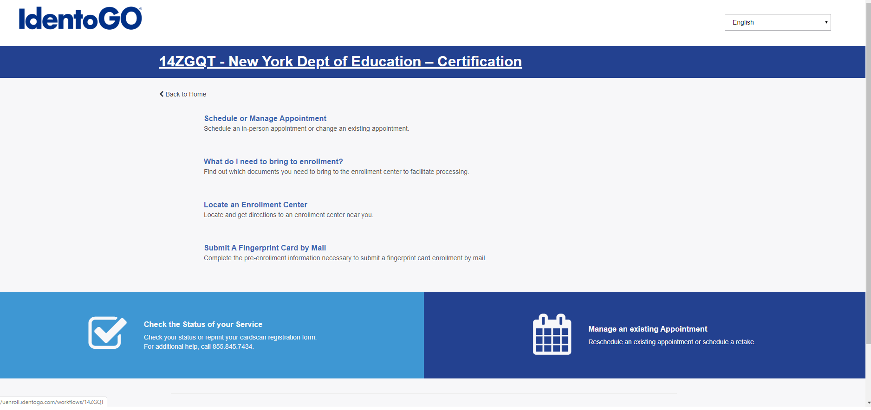
Schedule Fingerprinting for Certification Applicants

Slide 11
NYSTCE Exams
All teacher candidates are required to take a series of exams as part of their requirements to become certified to teach in New York State. The NYSTCE exam series is designed to ensure that certified teachers have the necessary knowledge and skills to be an effective teacher in the New York State public schools. Teacher candidates will not become NYS certified without a passing score on all the necessary exams.
Individuals seeking an Initial New York State teaching certificate must achieve qualifying scores on the following set of assessments:
Select Canisius College as your reporting school when enrolling for exams.
EAS- Educating All Students
CST - Content Specialty Test in the content area of the certification. (For example if you are seeking to be certified in English 7-12 you will take the CST for English. If you are seeking to be certified in any area of Elementary Education B-2 or 1-6, you will take the appropriate grade level Multi-Subject CST.)
You must register for the exams online http://www.nystce.nesinc.com using a credit card.

Slide 12
What about the new SWD All Grades Certification?
Right now NY State is saying that with the endorsement from Canisius College you will need to apply through Independent Pathway for the SWD All Grades Certification (after you have applied through “Approved Program Pathway” for your other certifications of Childhood (1-6) and SWD (1-6)
The state will check your official transcripts to make sure you have six credits of college level English classes
At this point your Childhood CST will count as the test but next year that will not be the case when the All Grades exam becomes available

Slide 13
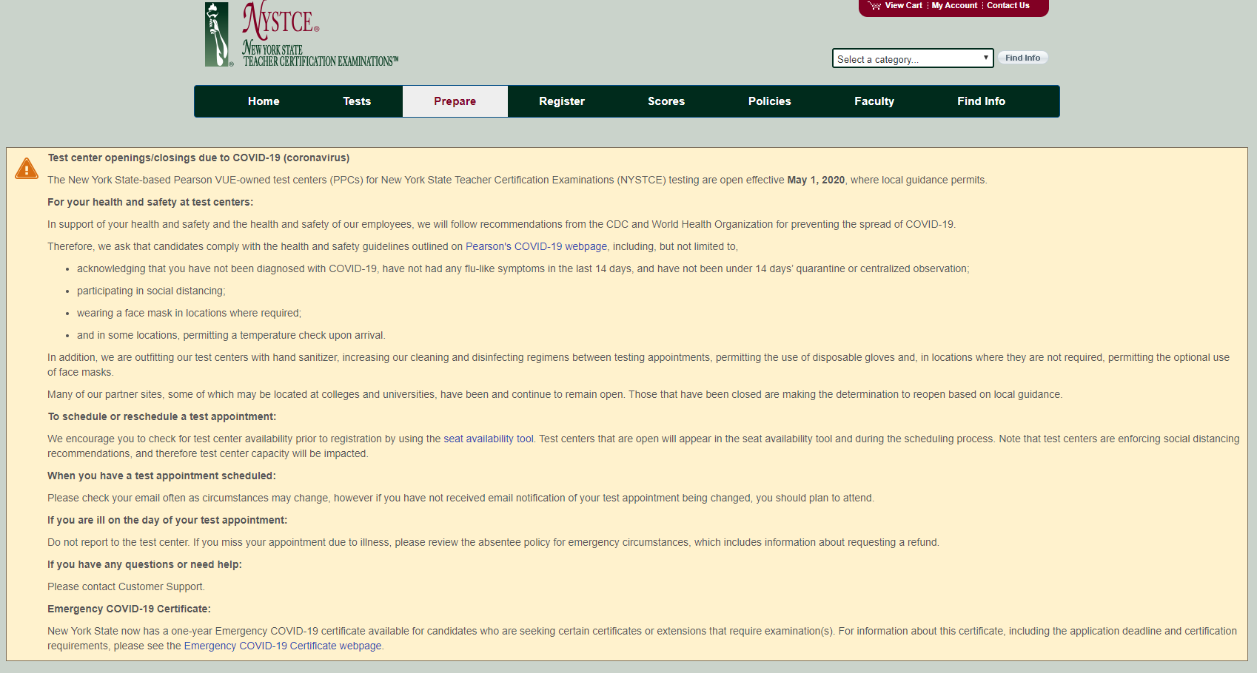
http://www.nystce.nesinc.com

Slide 14
How to Apply for Certification
http://www.highered.nysed.gov/tcert/certificate/apply.html

Slide 15
NYS TEACH Codes for Undergraduate Students
BACHELOR OF ARTS
24288 ADOLESCENCE ED: SOCIAL STUDIES 7-12
24292 ADOLESCENCE EDUCATION: BIOLOGY 7-12
24293 ADOLESCENCE EDUCATION: CHEMISTRY 7-12
24286 ADOLESCENCE EDUCATION: ENGLISH 7-12
24289 ADOLESCENCE EDUCATION: FRENCH 7-12
24290 ADOLESCENCE EDUCATION: GERMAN 7-12
24287 ADOLESCENCE EDUCATION: MATHEMATICS 7-12
24294 ADOLESCENCE EDUCATION: PHYSICS 7-12
24291 ADOLESCENCE EDUCATION: SPANISH 7-12
BACHELOR OF SCIENCE
24295 PHYSICAL EDUCATION
24283 SPECIAL EDUCATION – EARLY CHILDHOOD ED (no longer have this program)
24285 SPECIAL EDUCATION – CHILDHOOD
39195 CHILDHOOD (1-6) – TESOL (K-12)
28450 PHYSICAL EDUCATION/HEALTH EDUCATION
19148 ATHLETIC TRAINING

Slide 16
NYS TEACH Codes for Graduate Students
ADVANCED CERTIFICATES
35760 BILINGUAL EDUCATION
35241 BILINGUAL EDUCATION: ITI
35998BILINGUALSPECIAL EDUCATION
35997 BILINGUAL SPECIAL EDUCATION: ITI
31510 GIFTED EDUCATION
28577 PHYSICAL EDUCATION
29139 SCHOOL BUILDING LEADER
81101 SCHOOL COUNSELING
29140 SCHOOL DISTRICT LEADER
35240 TCHNG ENG TO SPKRS OF OTHER LANGS
36874 TESOL SPECIAL EDUCATION: ITI
MASTER OF SCIENCE
29141 EDUCATIONAL LEADERSHIP AND SUPERVISION
35323 EDUCATL TECHNOLOGIES & EMERGING MEDIA
4312 SCHOOL COUNSELING
35239 TCHNG ENG TO SPKRS OF OTHER LANGS
28281 TEACHING STUDENTS WITH DISAB: CHILDHOOD
MASTER OF SCIENCE IN EDUCATION
28284 ADOLESENCE EDUCATION
28286 ADOLESCENCE EDUCATION: HISTORY
39010 BIOLOGY & SWD GENERALIST 7-12
28287 BUSINESS AND MARKETING
39006 CHEMISTRY & SWD GENERALIST 7-12
39664 CHILDHOOD (1-6) TESOL (K-12)
39494 CHILDHOOD 1-6/SPEClAL EDUCATION 1-6
28282 CHILDHOOD EDUCATION
30635 DIFFERENTIATED INSTRUCTION
36973 EARLY CHILDHOOD URBAN EDUCATION- ALT CERT
38779 ENGLISH & SWD GENERALIST 7-12
39007 HISTORY & SWD GENERALIST 7-12
28289 LITERACY EDUCATION - BIRTH-GRADE 6
28290 LITERACY EDUCATION - GRADES 5-12
39005 MATH & SWD GENERALIST 7-12
28575 PHYSICAL EDUCATION
28576 PHYSICAL EDUCATION (ONLINE PROFESSIONAL ONLY)
39009 PHYSICS & SWD GENERALIST 7-12
37769 SPECIAL EDUCATION
36839 TRANS B: ADOL URBAN EDUC -ALT CERT (TFA)
36838 TRANS B: CHIDHD URBAN EDUC-ALT CERT (TFA)
41037 PHYSICIAN ASSISTANT (MASTER’S)
30705 CLINICAL MENTAL HEALTH COUNSELING (MASTER’S)
35456 CLINICAL MENTAL HEALTH COUNSELING (ADVANCED CERT)

Slide 17
Certification Information
Certification from Start to Finish
http://www.highered.nysed.gov/tcert/certificate/certprocess.html
Undergraduate Certification Recommendation Information
Undergraduate students receive a recommendation from the college for certification once a Bachelor's degree has been awarded and that student has a TEACH account.
Graduate Certification Endorsement Information
Graduate students who student teach in their last semester and are looking for initial certification in the following programs: Childhood, Adolescence, Physical Education or Special Education and, who successfully complete all Canisius and pre-requisite requirements, will automatically be recommended for certification once the final semester grades have been submitted. Students must have a TEACH account to be endorsed.
All other Canisius graduate education students, regardless of program completed, request endorsement through this link;
apps.canisius.edu/eduendorsement
You may also find the link on the MyCanisius portal or
Call School of Education 716-888-2391
Recommendations take approximately 2-5 working days to be processed.

Slide 18
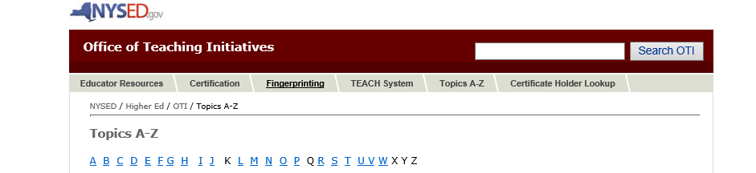
Questions………
http://www.highered.nysed.gov/tcert/teach/teachappfaq.html
Very Helpful Link – will answer most questions

Slide 19
Still Have Questions………
Canisius College TEACH contact:
Ginny Carver 716-888-2391 or carverv@canisius.edu
TEACH Contact Info:
Teacher Certification Helpline: tcert@nysed.gov or 518-474-3901
TEACH online system: 518-486-6041 (Available M-F 9:00am-4:00pm)
or via email: teachhelp@mail.nysed.gov.
Fingerprinting: 518-473-2998 Accessibility Questions: 518-473-4501
Other Helpful Websites……
http://www.highered.nysed.gov/tcert/certificate/ Certification from start to finish
http://www.nystce.nesinc.com/ Up-to-date certification exam information
Notes:
Information if you need to contact any of us for any reason. Or check for information. Also if you need to use a safety net you will email examsafetynet@nysed.gov and ask for the safety net to be applied.

